Slide 1
Coexistence and Adaptations: Juvenile Pink and Chum Salmon Feeding Behaviour in B.C.
Vanessa Fladmark
MSc Thesis Project
PEL Meeting
March 30th, 2020

Slide 2
Outline
Introduction
Chapter 1 – A difficult route: Juvenile pink and chum salmon diets
Chapter 2 – Coexistence over time: Juvenile pink and chum strategies
Conclusion

Slide 3
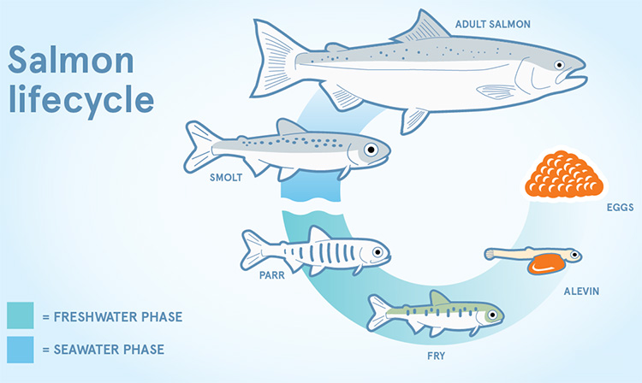
Introduction Chapter
Salmon life history
Marine survival
Competition
Prey switching
Coexistence

Slide 4
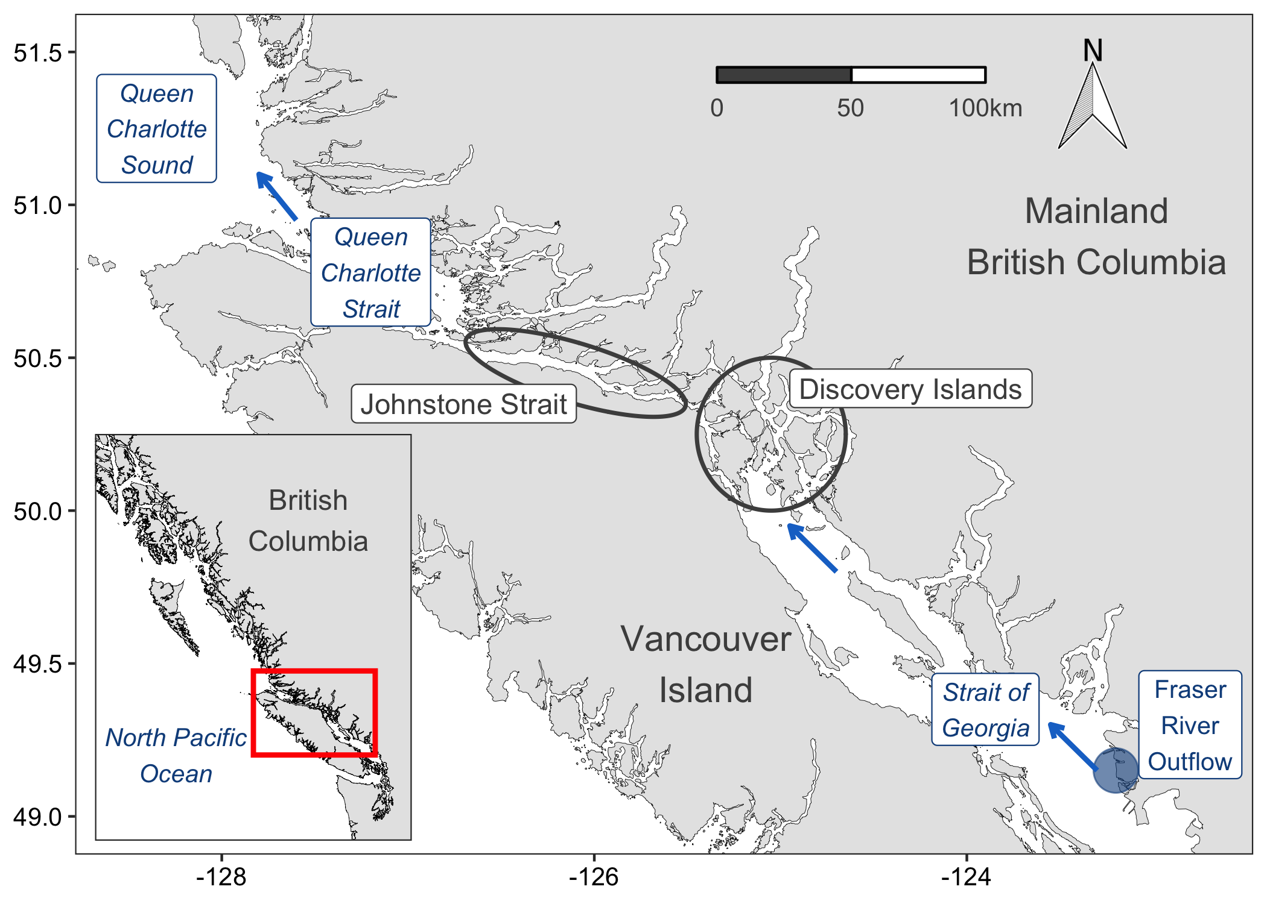
Spatial Chapter – Introduction
Salmon: Early migration
Discovery Islands: Complex archipelago
Johnstone Strait: “Trophic gauntlet”
Queen Charlotte Strait: Feeding refuge
Pink salmon: Foraging
Chum salmon: Foraging

Slide 5
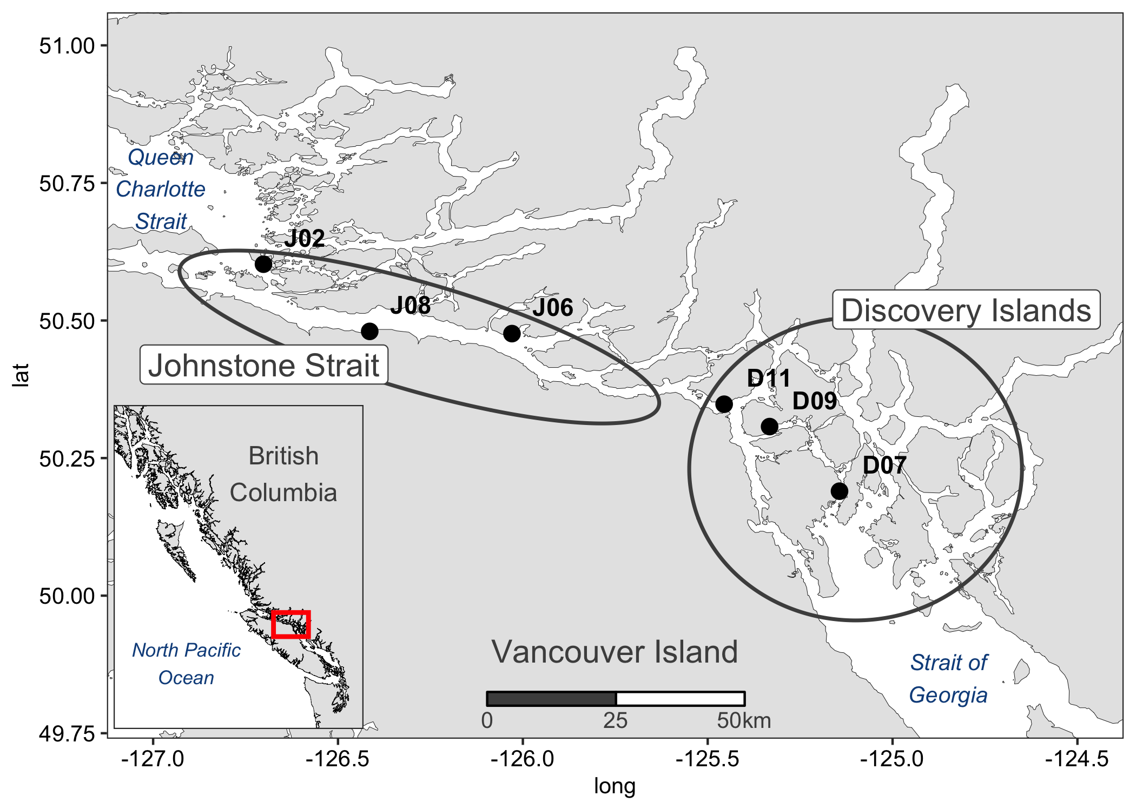
Chapter 1 – A difficult route (Spatial data)
Spatial – Methods: June 8-16th, 2016
ethods (sampling design comes first? Maybe even in prev. slide
n = 60
n = 60

Slide 6
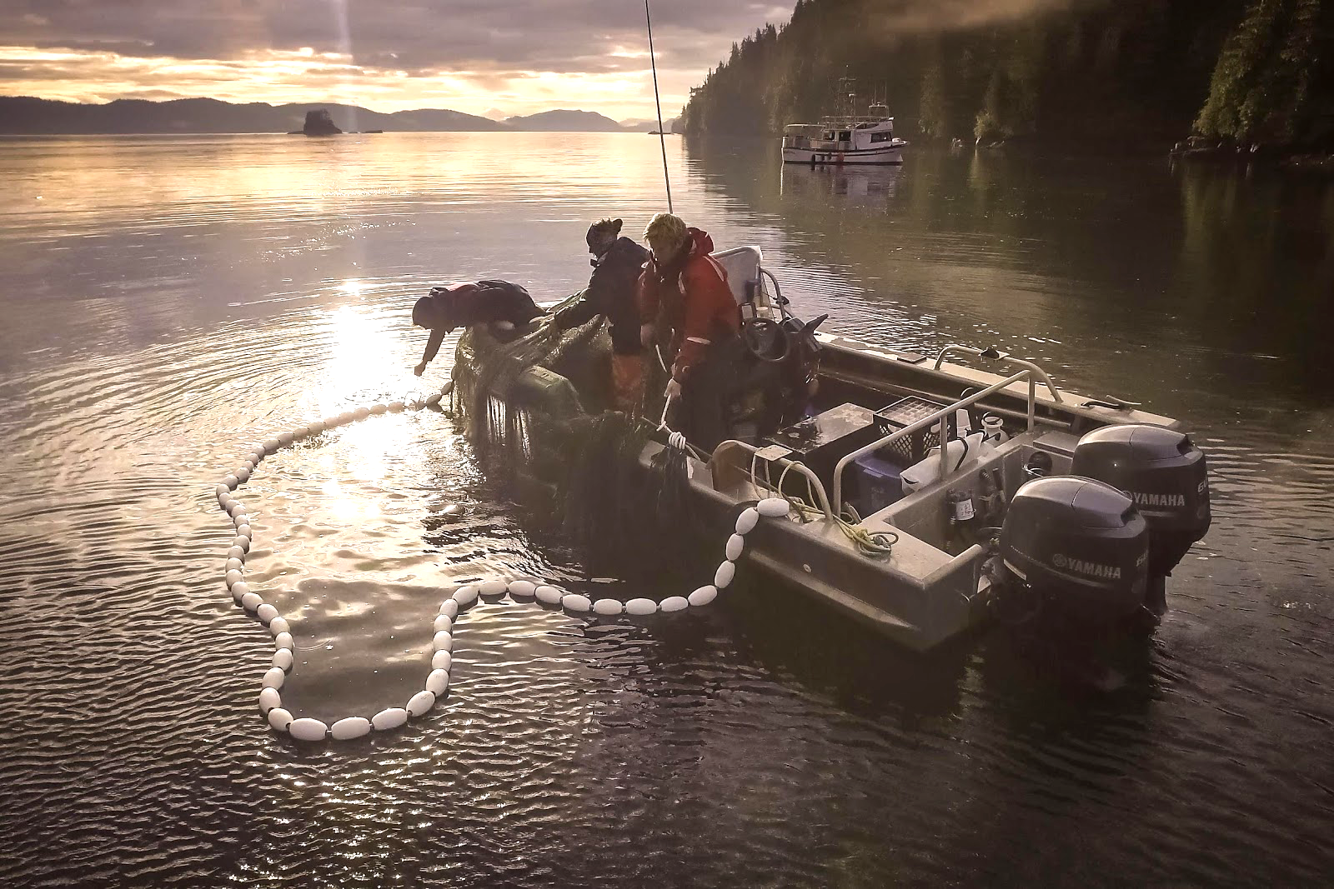
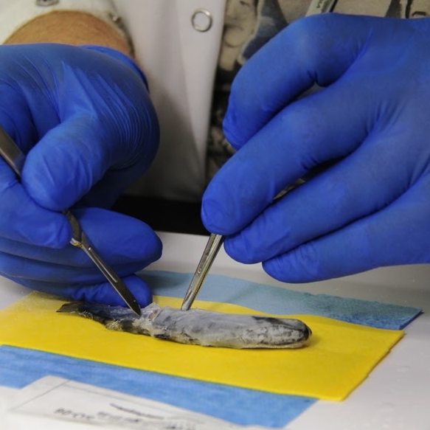
Spatial Chapter – Methods
Juvenile salmon program field sampling

Slide 7
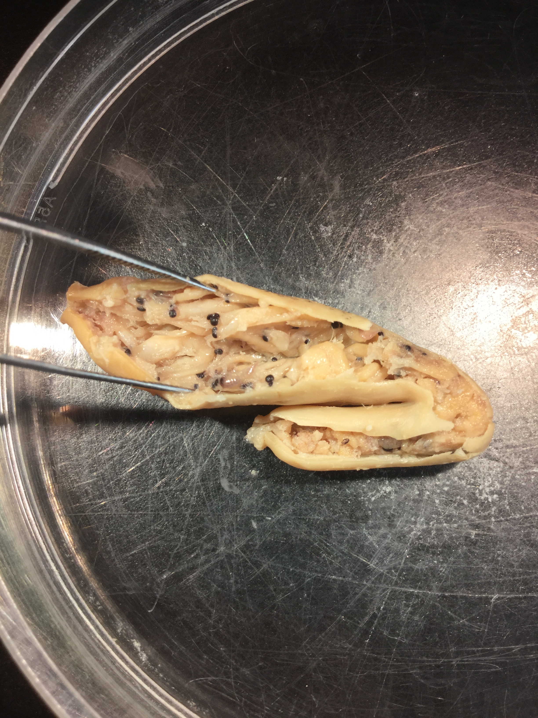
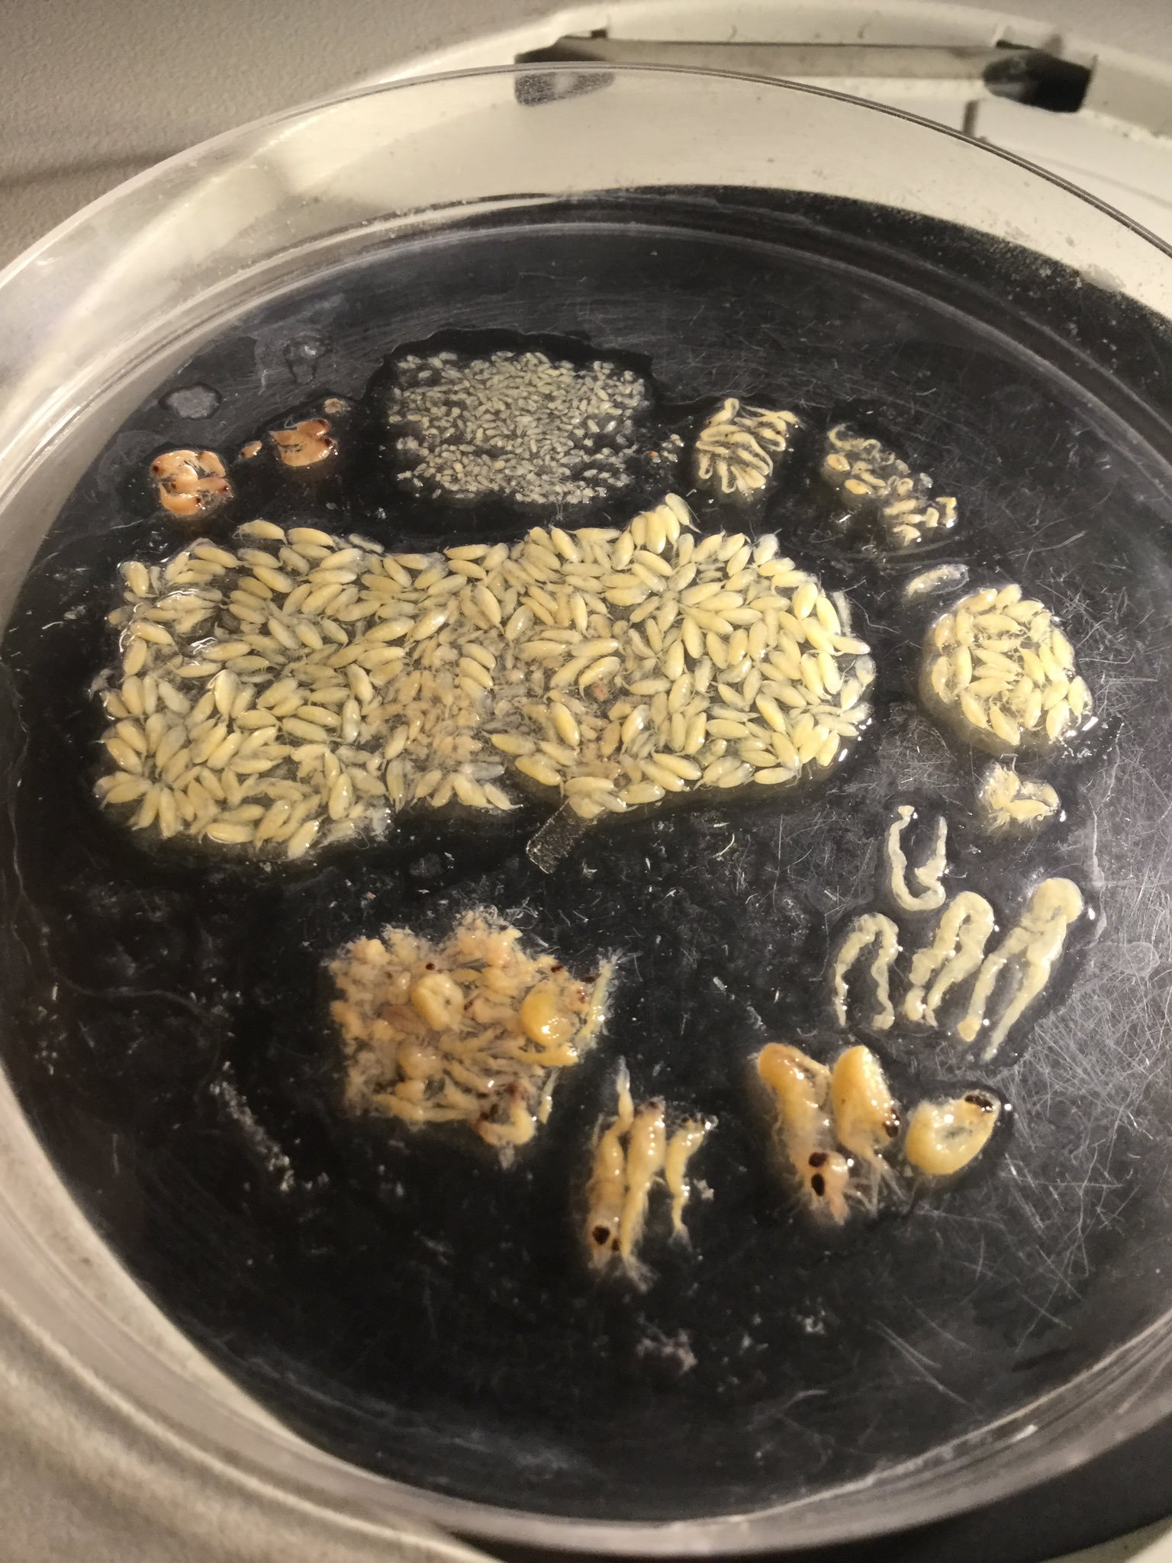
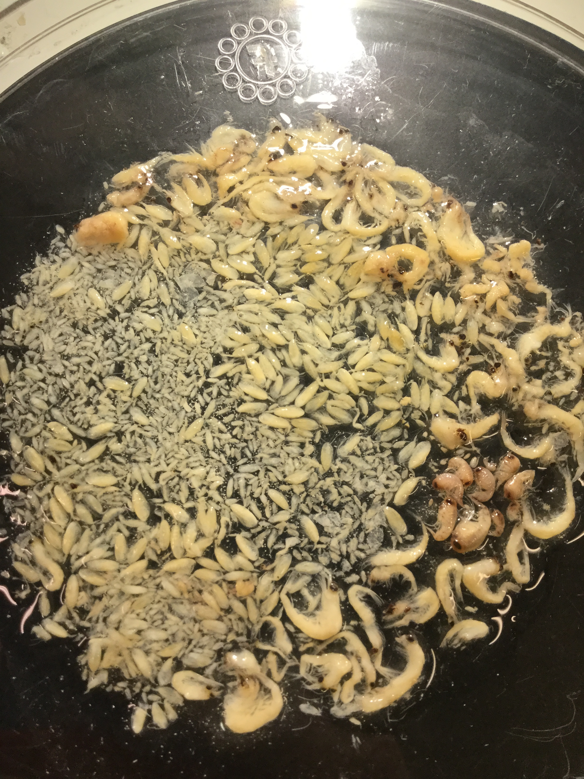
Spatial Chapter – Methods
Stomach content analysis (looking inside tummies!)

Slide 8
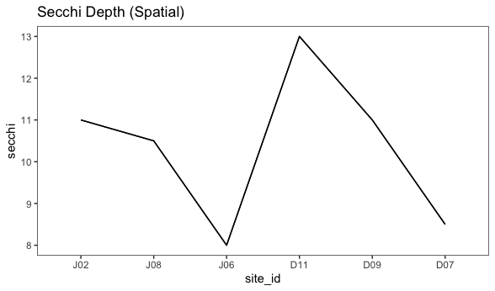
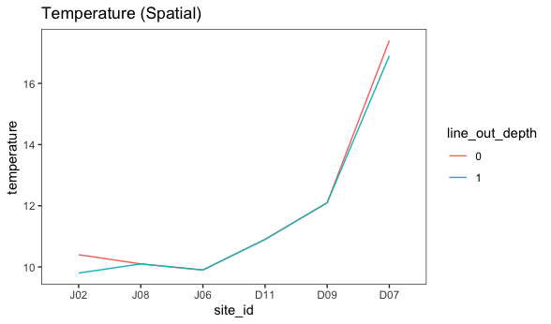
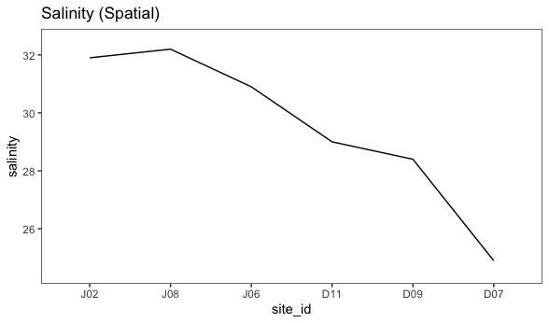
Spatial Chapter – Results
Environmental data (paired w/fish)

Slide 9
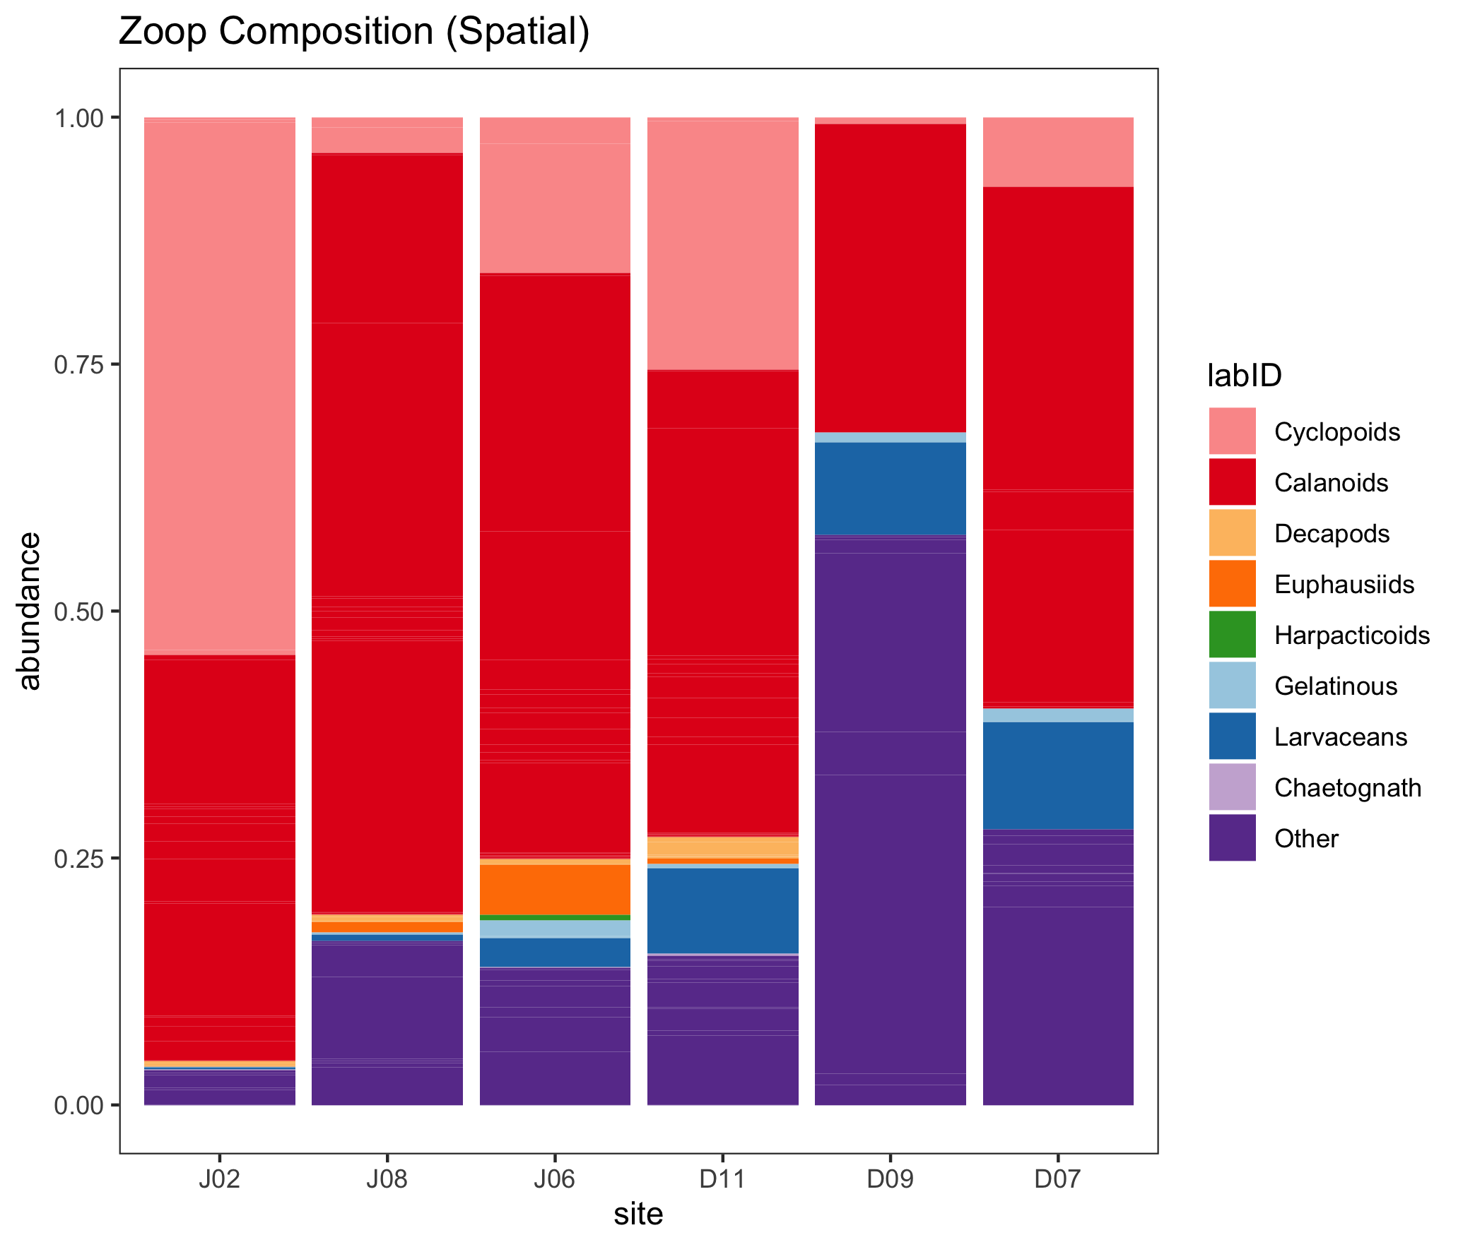
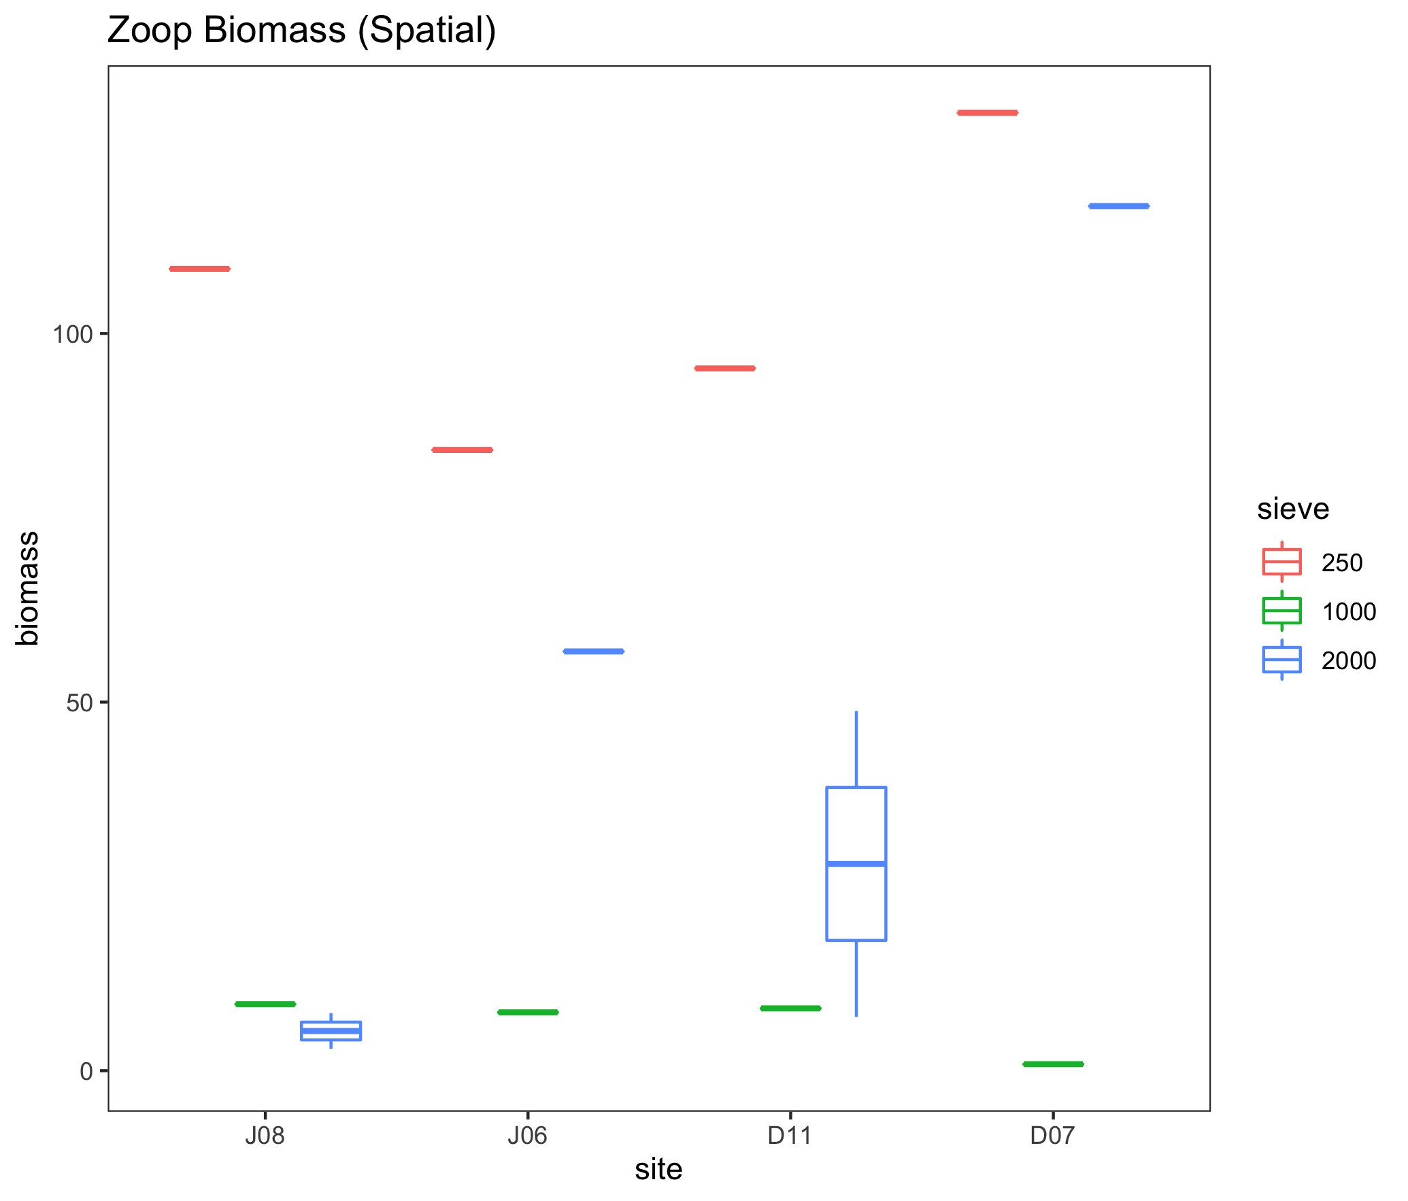
Spatial Chapter – Results
Zooplankton (paired w/fish)

Slide 10
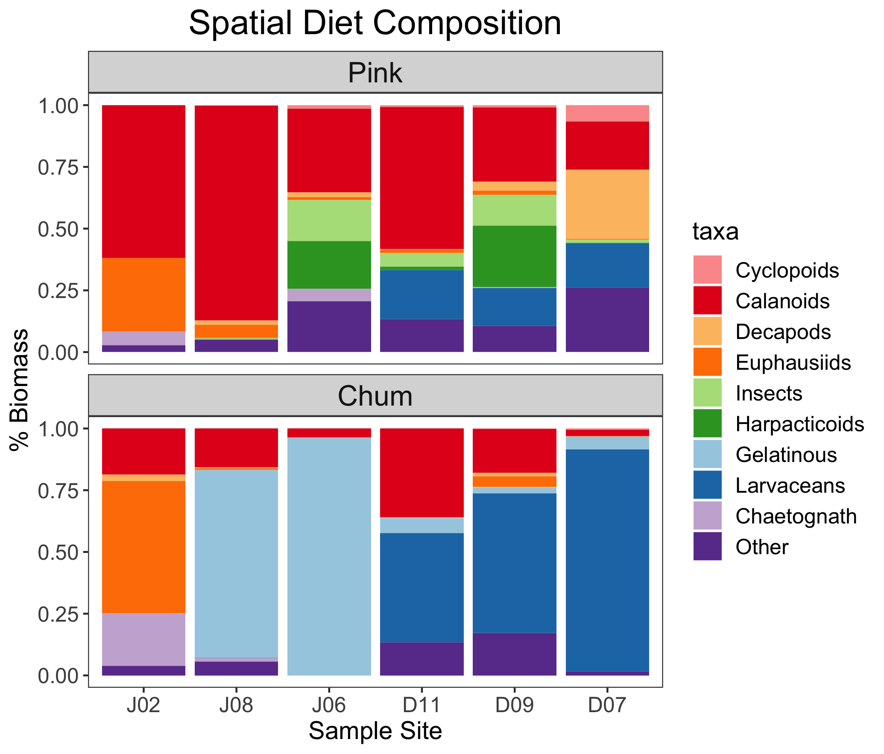

Slide 11
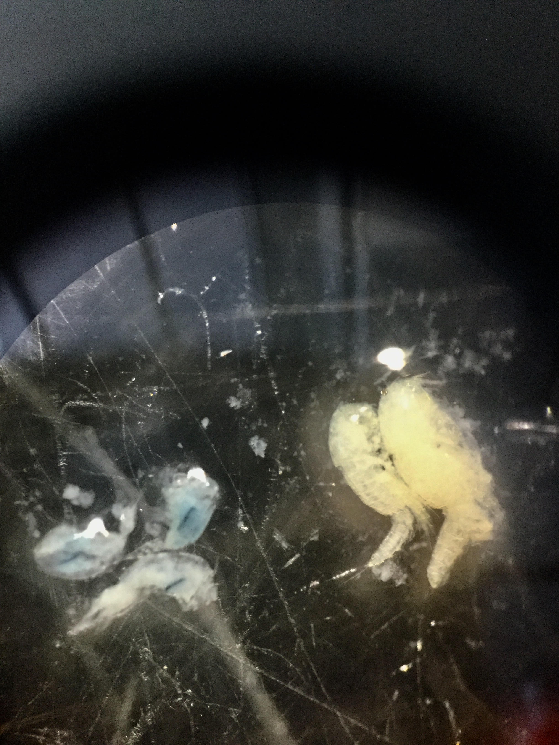
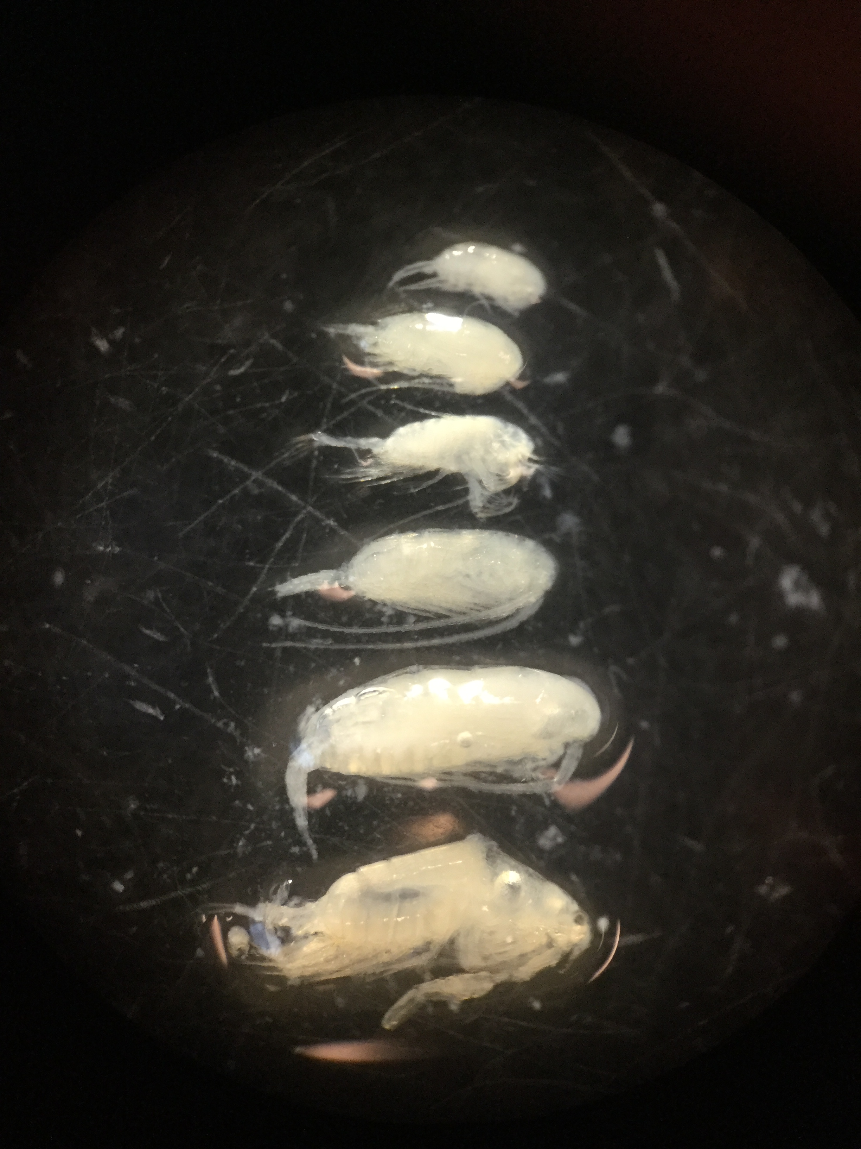
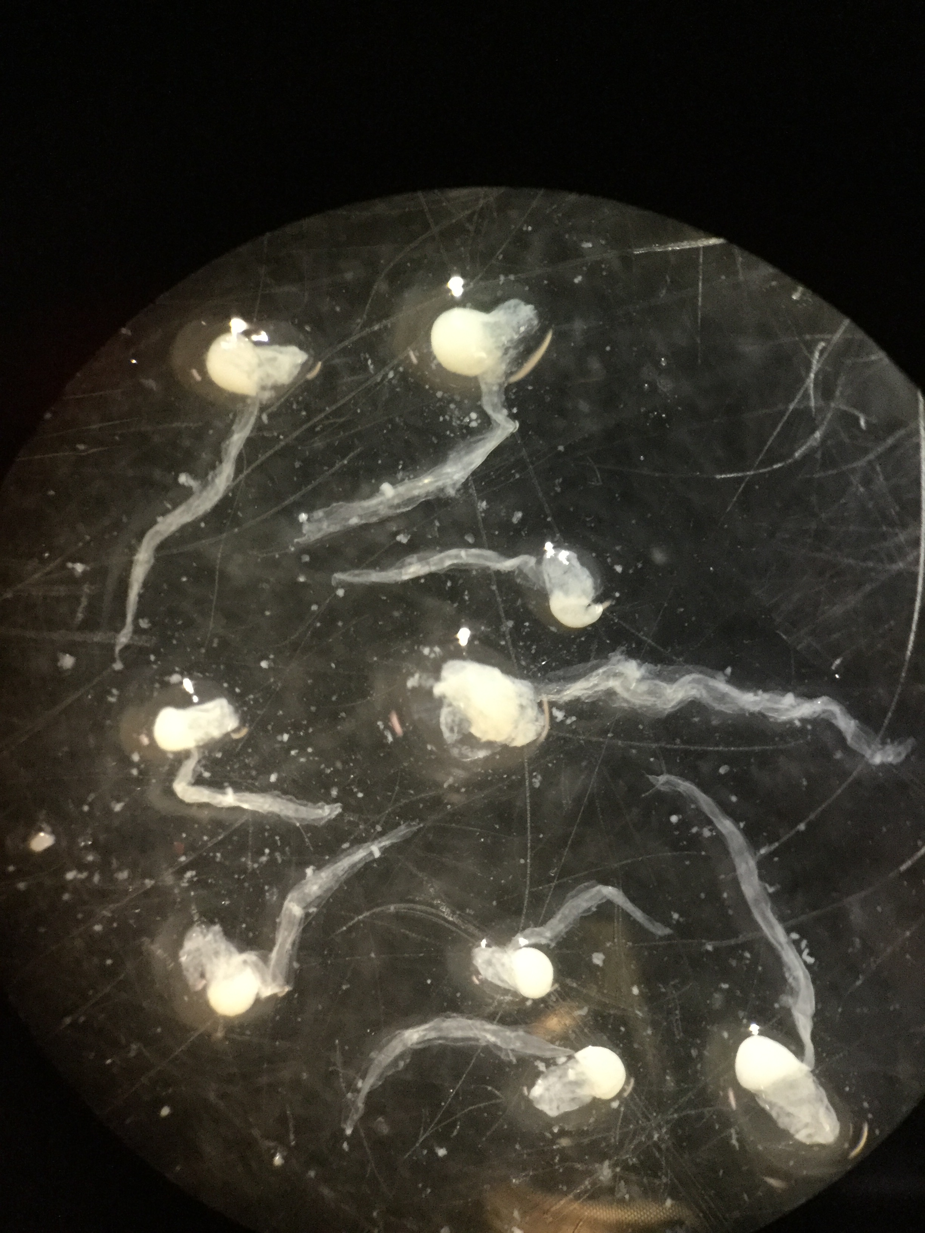
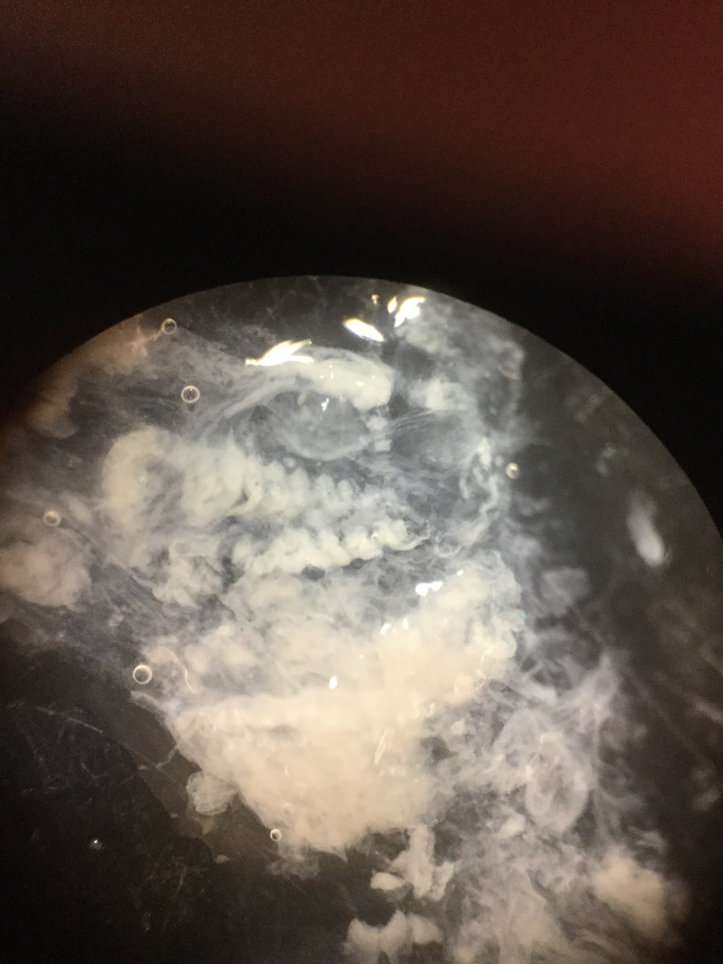
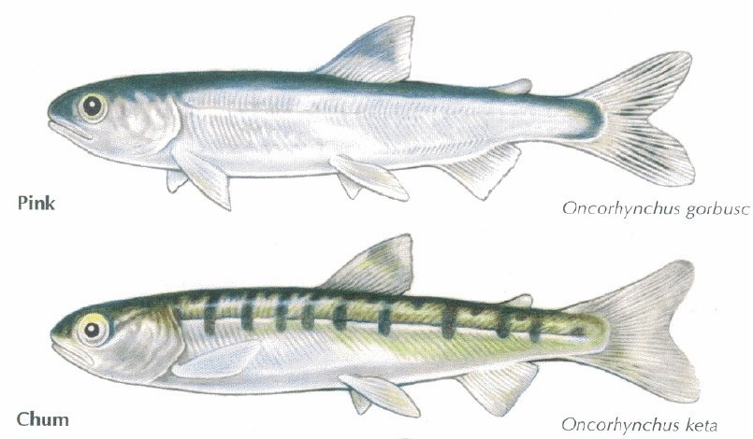

Slide 12
Spatial Chapter – Results
Prey selectivity (need to update these graphs – simplify the groups!)

Slide 13
Spatial Chapter – Results
Foraging habitats (look at prey composition for this? Other things??)

Slide 14
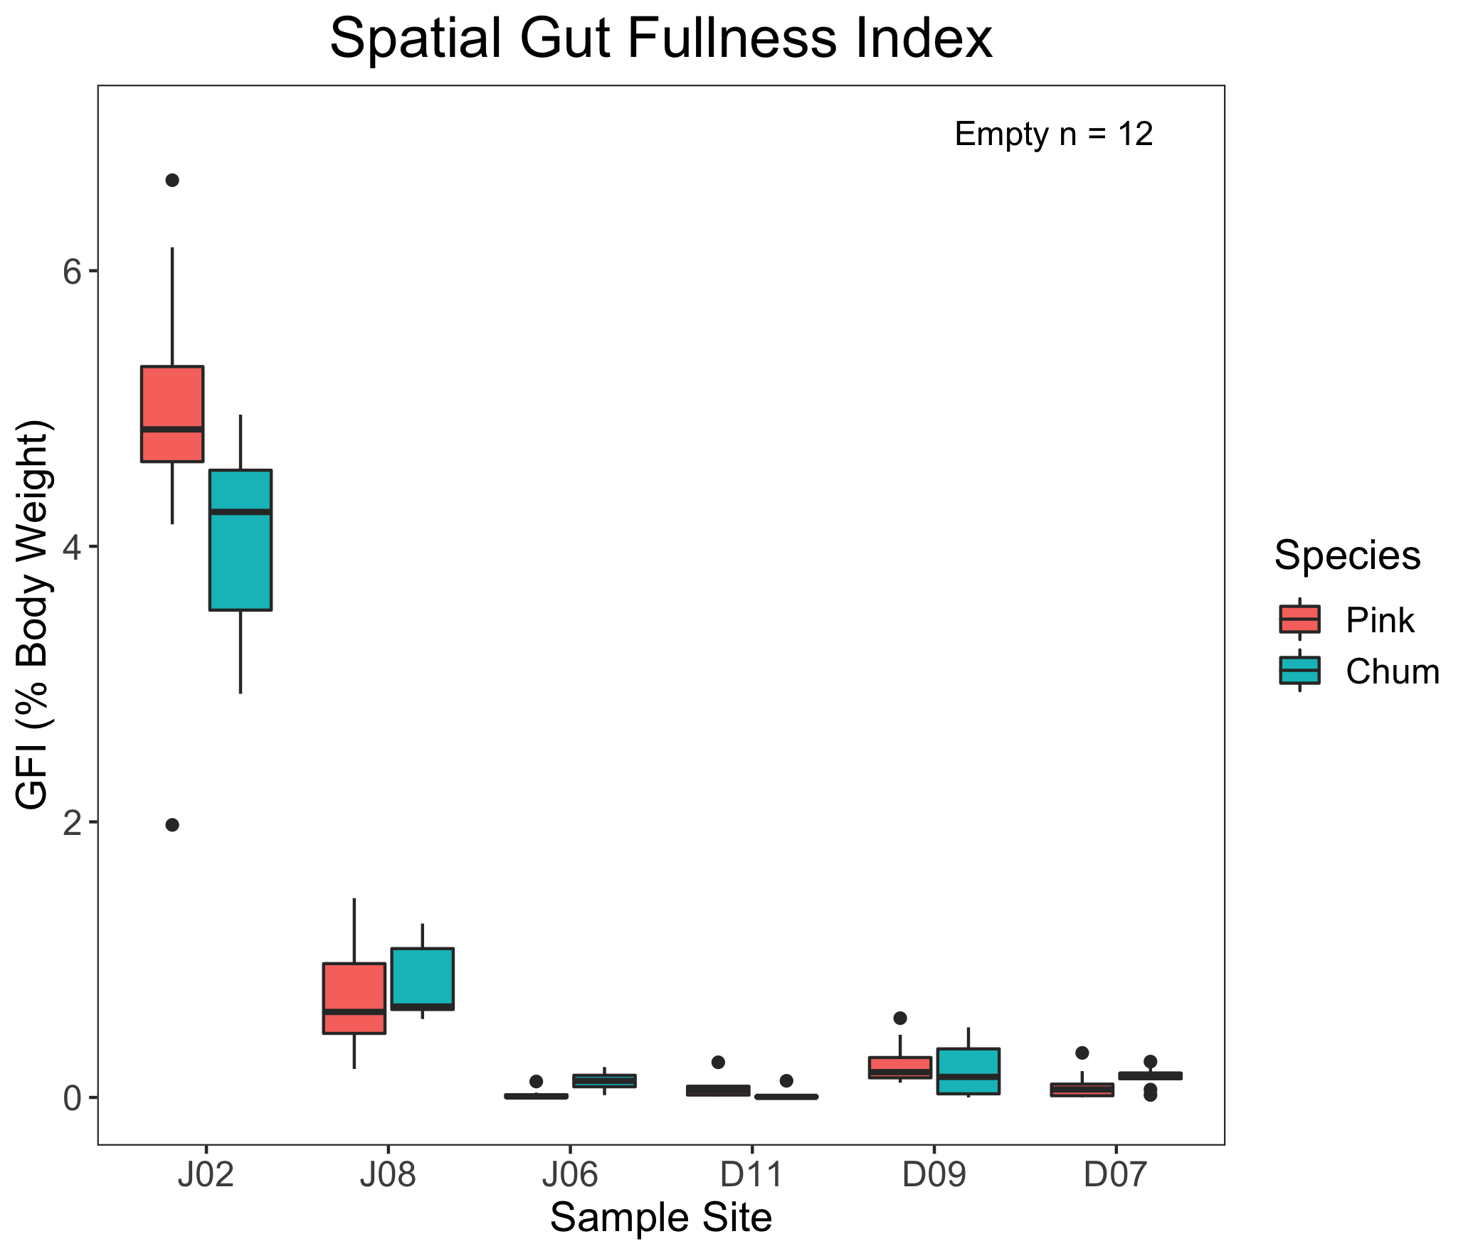

Slide 15
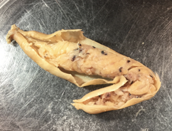
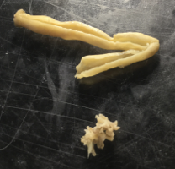

Slide 16
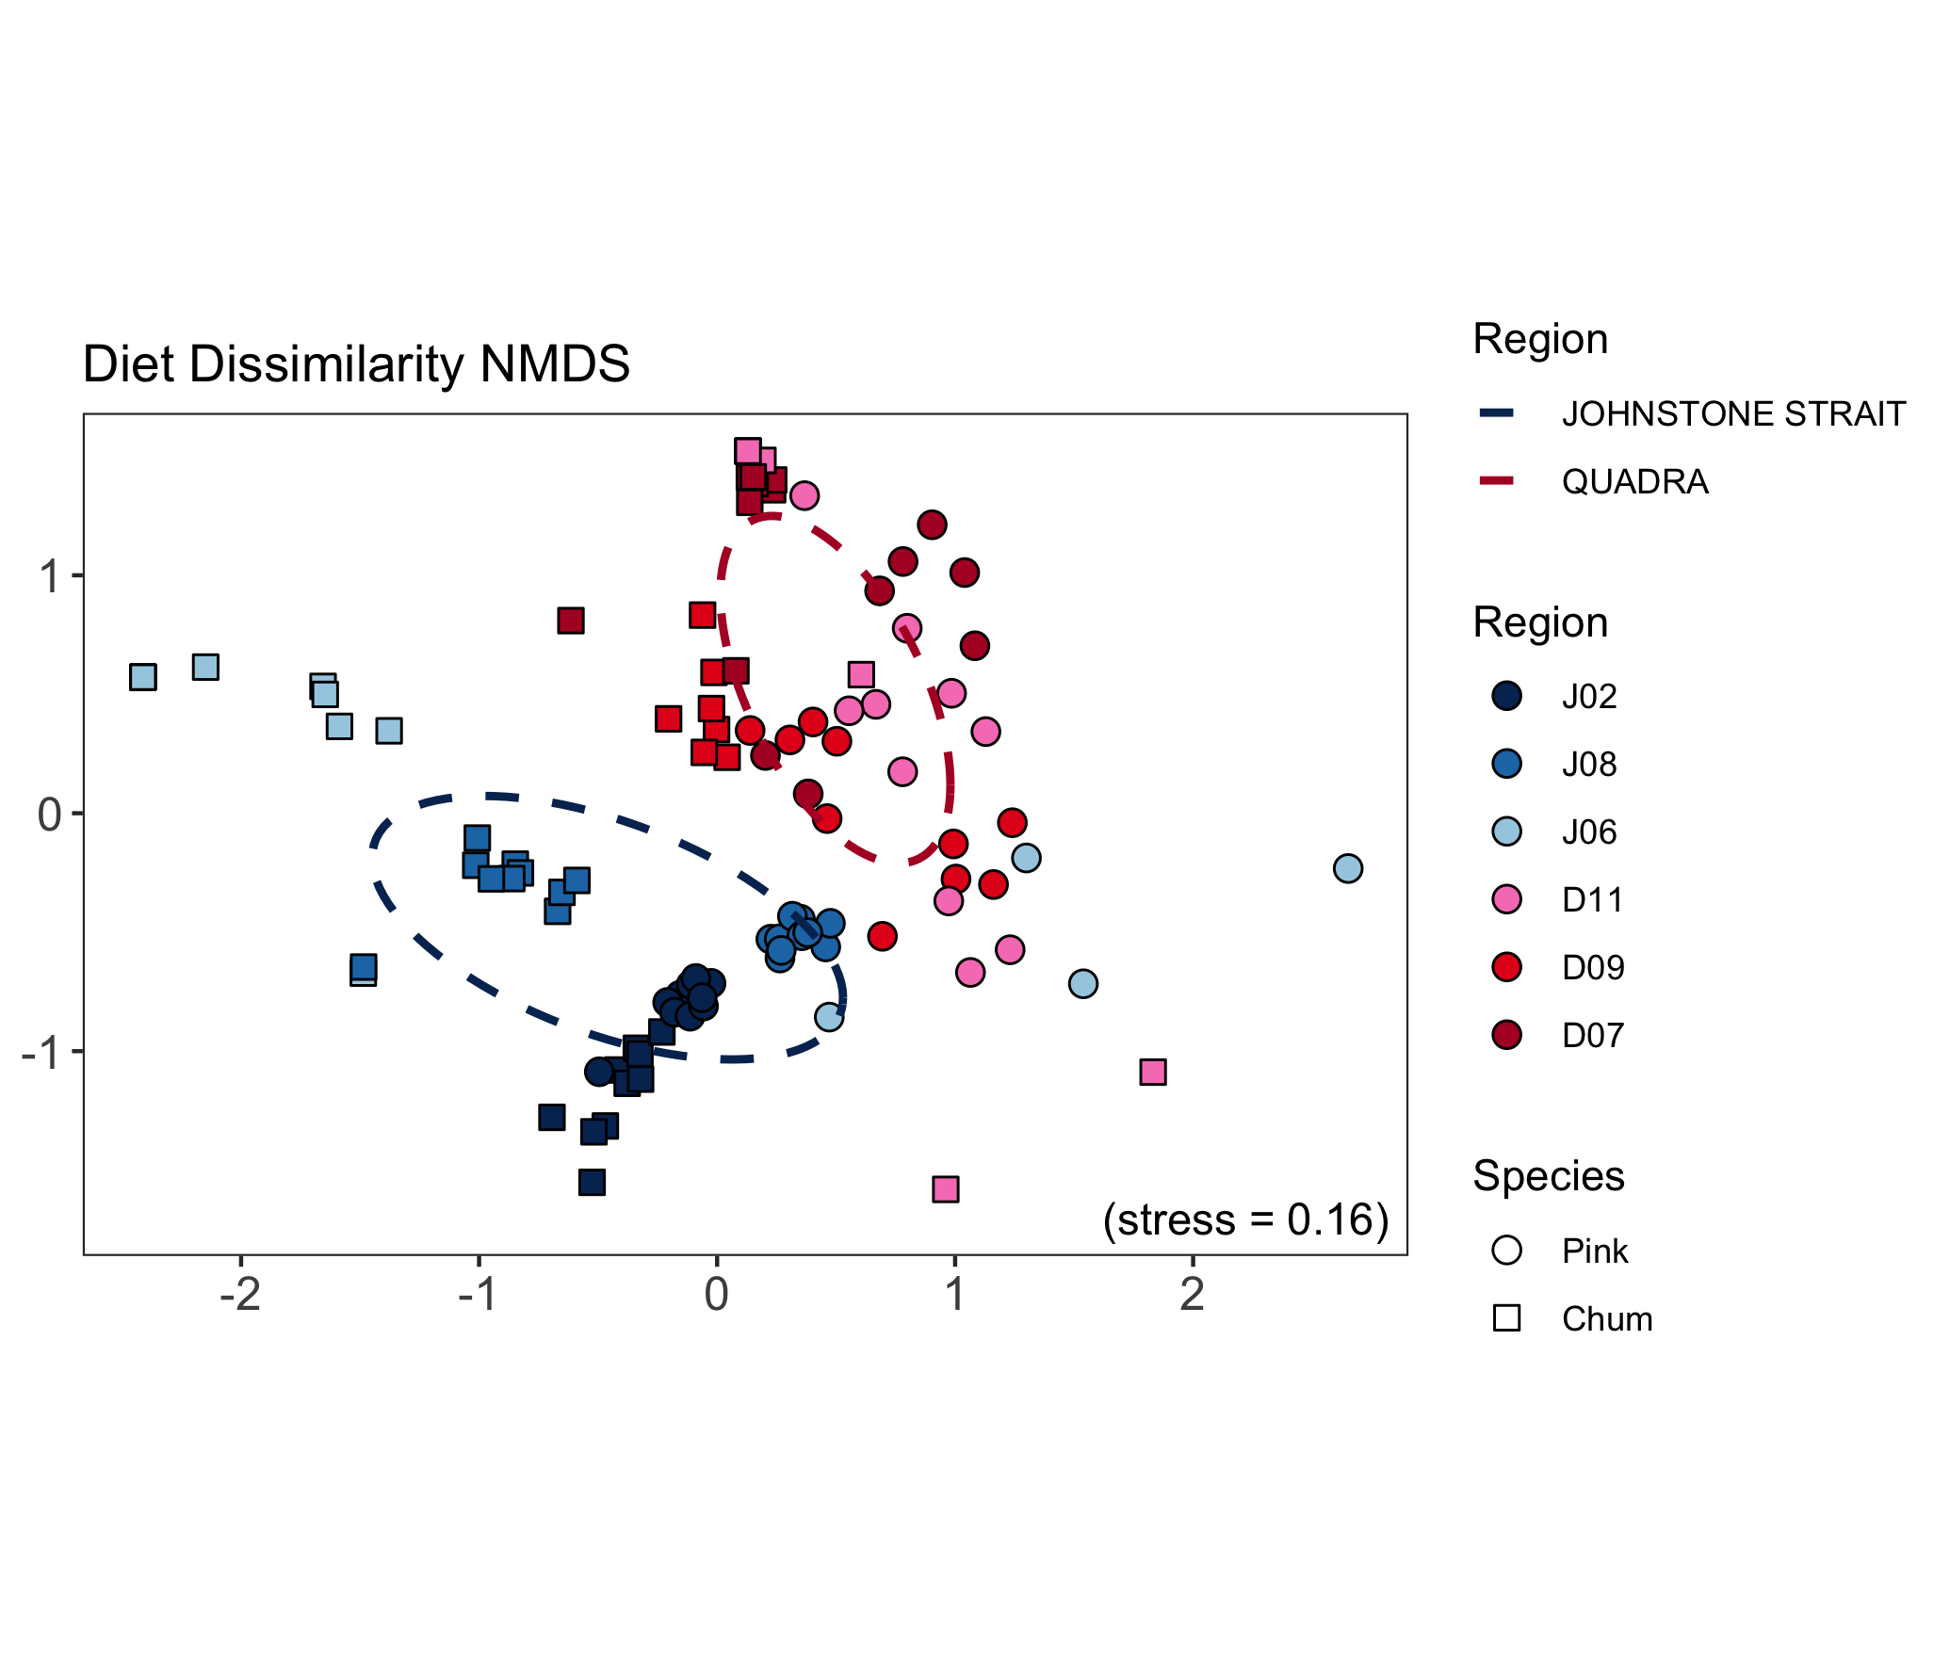
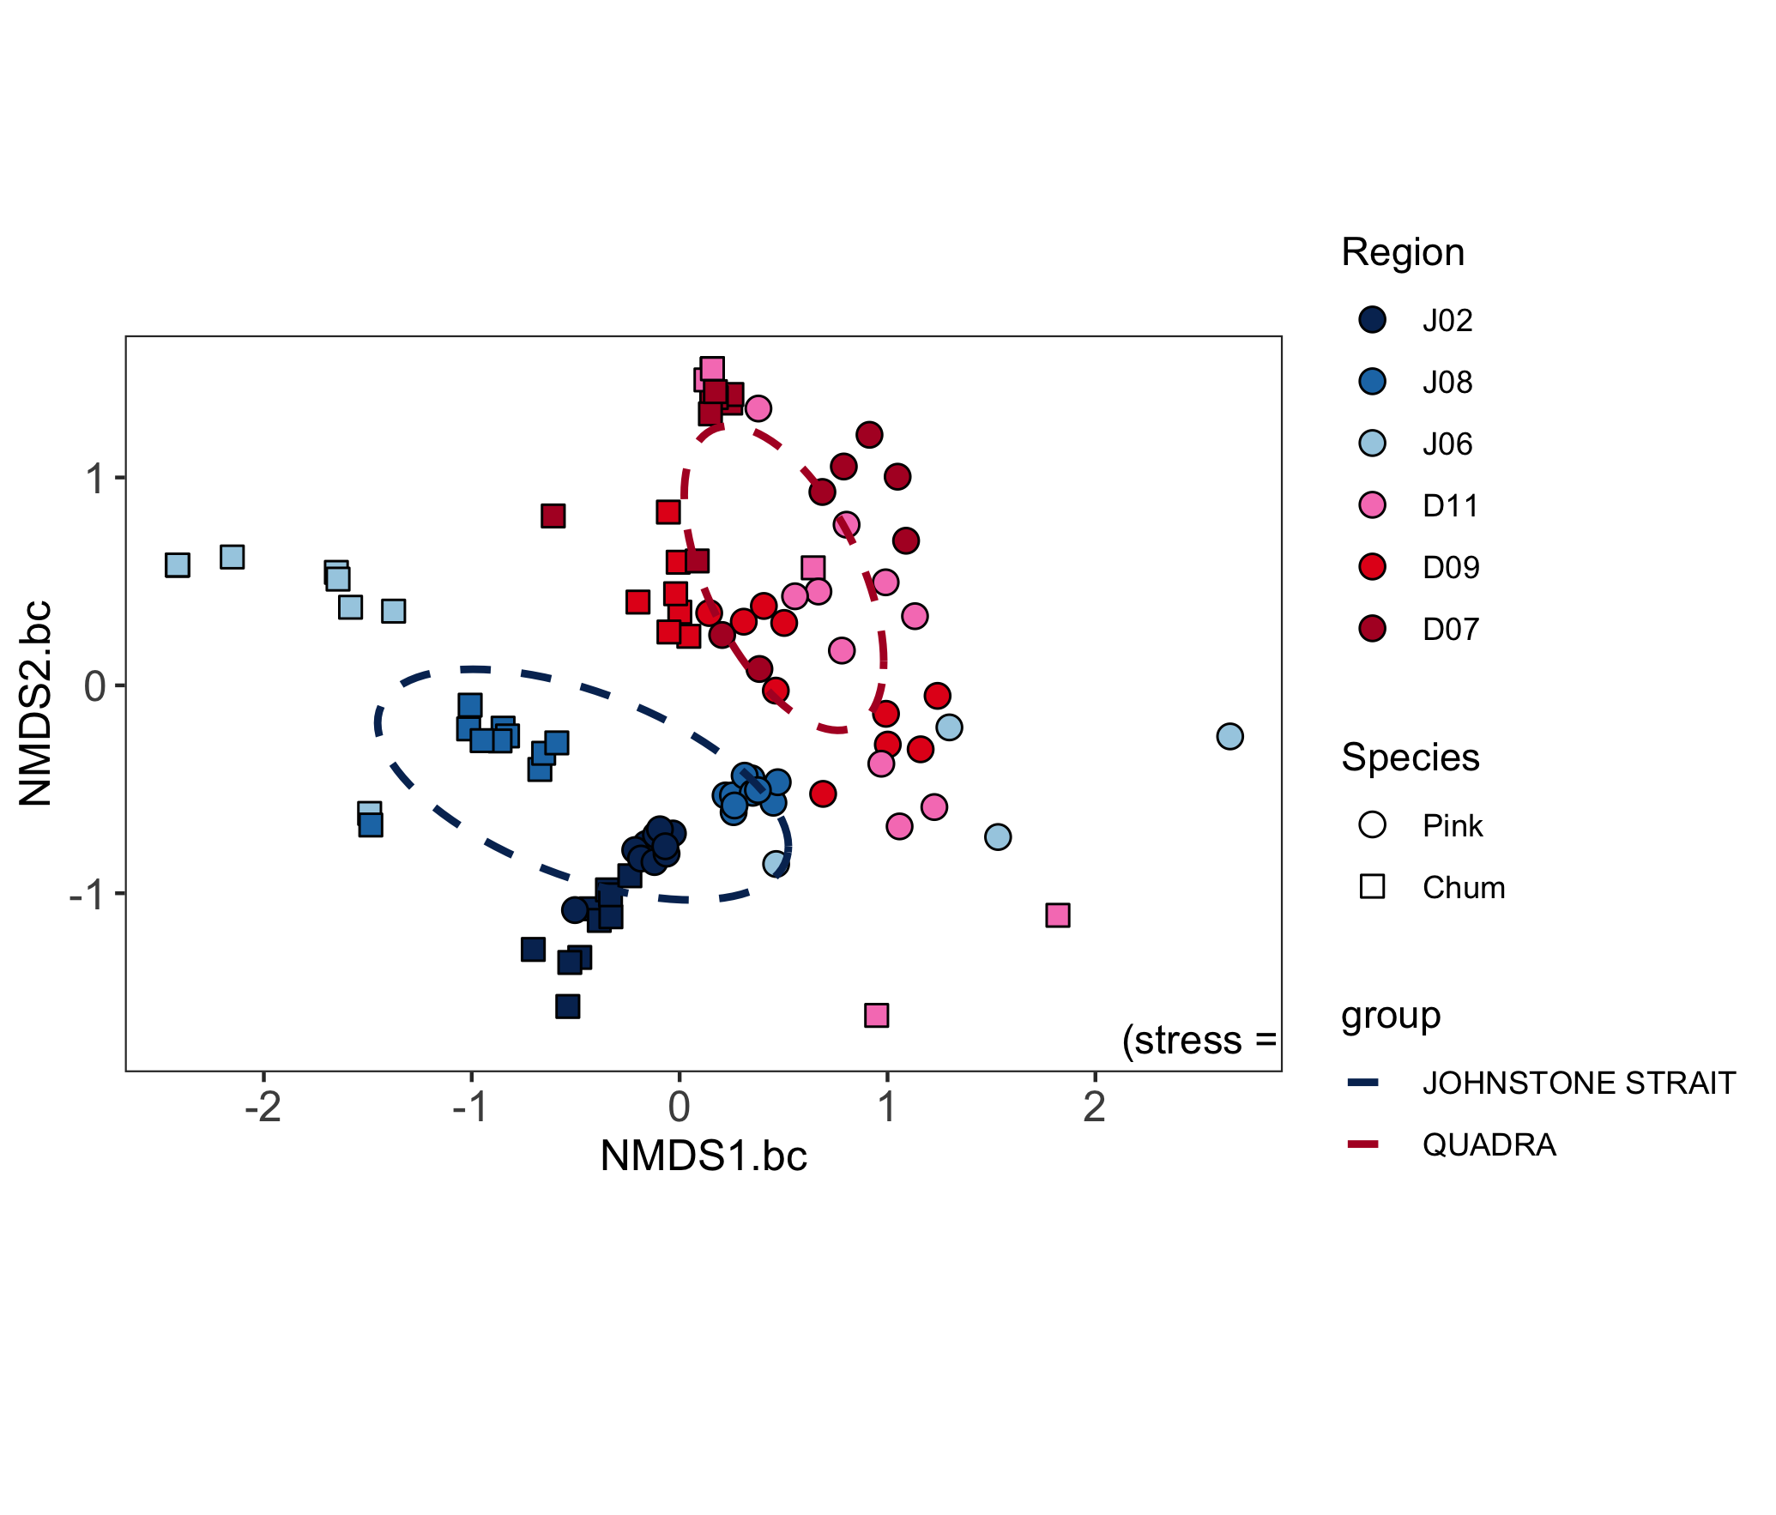
Spatial Chapter – Results

Slide 17
Spatial Chapter – Results
High foraging: similar diets Low foraging: different niches

Slide 18
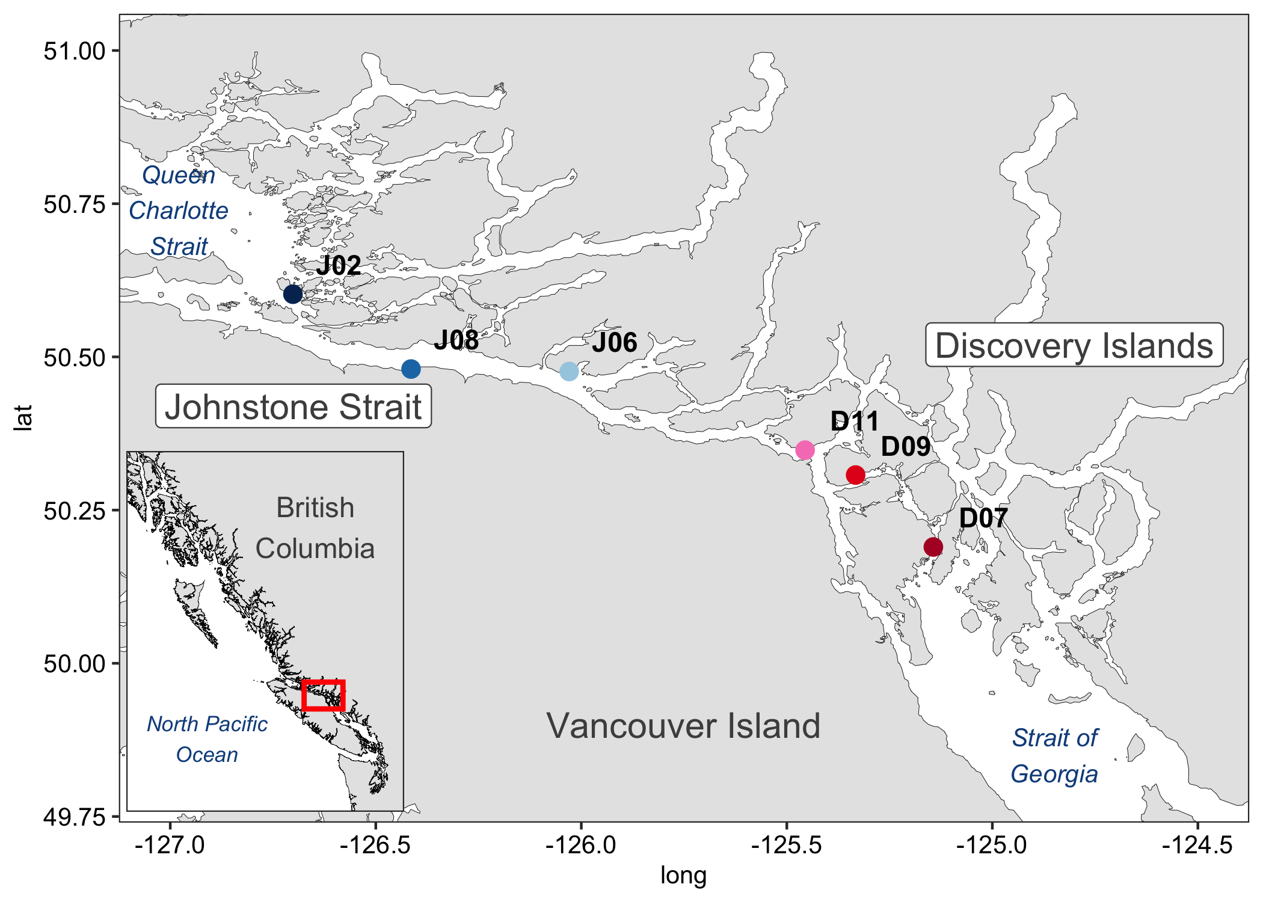
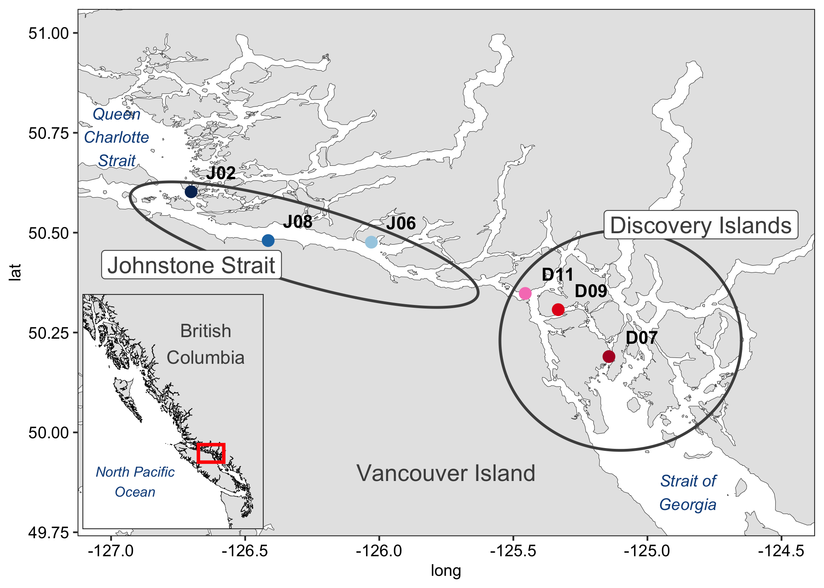
Spatial Chapter – Discussion
Discovery Islands: The gauntlet begins
Transition zone: Winners and losers
Johnstone Strait: Salmon prey shifts
Queen Charlotte Strait: Replenishment

Slide 19
Spatial Chapter – Discussion + Conclusion
Discovery Islands: The gauntlet begins
Transition zone: Winners and losers
Johnstone Strait: Salmon prey shifts
Queen Charlotte Strait: Replenishment
Migration route challenges
Adaptations through prey switching
Salmon species interactions

Slide 20
Temporal Chapter – Introduction
Coexisting species
Prey partitioning
Foraging niches
Salmon migration
Pink vs. chum salmon

Slide 21
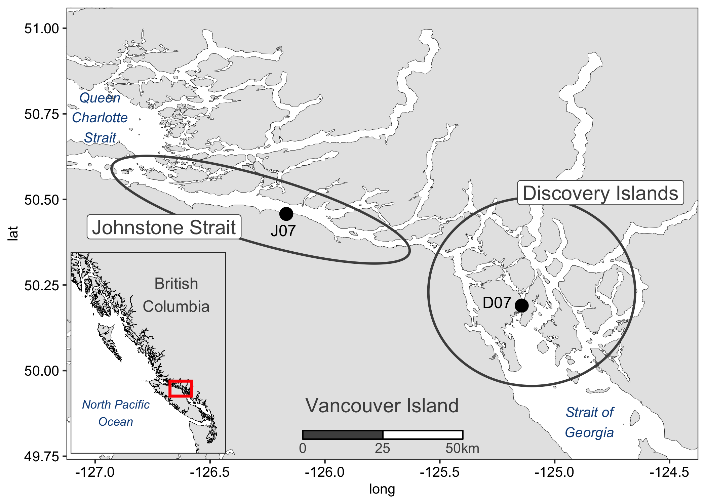
Chapter 2 – Coexistence over time (Tempo
Temporal: May-July 2015 and 2016
Methods (sampling map and dates; other methods already cove
red.)
n = 109
n = 87

Slide 22
Temporal Chapter – Results (TBD)
Environment and prey seasonality
Prey selectivity shifts
Foraging habitats
Feeding intensity
Salmon interactions
Very similar to Chapter 1 result layout w diff data (framed differently)

Slide 23
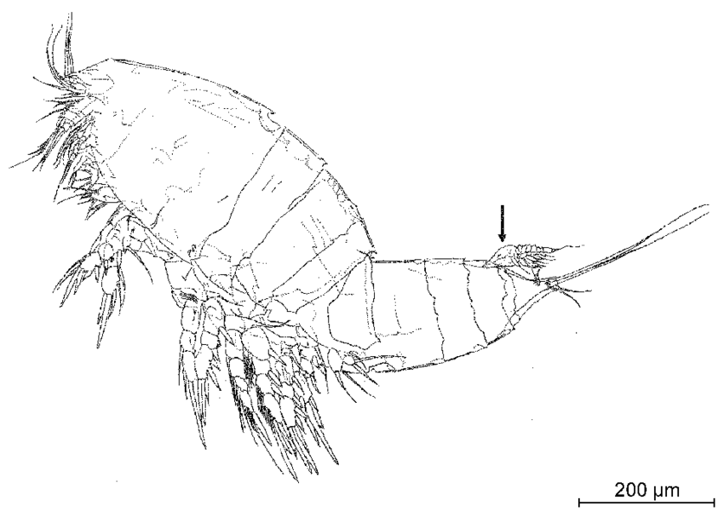
Temporal Chapter – Discussion + Conclusion
Discovery Islands: Zooplankton community succession
Johnstone Strait: Species prey choices diverge
Pink salmon: Foraging in the nearshore
Chum salmon: Gelatinous prey
Prey communities drive salmon interactions
Coexistence through prey specializations
Same school of fish, different habitats

Slide 24
Conclusion Chapter
Discovery Islands: Dynamic ecology
Johnstone Strait: Foraging gradient
Pink salmon: Crustacean prey
Chum salmon: Gelatinous prey
Species coexistence
Adaptation to conditions

Slide 25
Spatial Chapter – Results

